Slide 1
Troubleshooting missing COUNTER data in Alma
Yoel Kortick
Senior Librarian

Slide 2
Introduction
Why might COUNTER data be missing
Troubleshooting the missing COUNTER data

Slide 3
Introduction

Slide 4
Introduction
Time periods of missing COUNTER data can be viewed at:
  Acquisitions > Import > Load Usage data
  “Missing Data” tab.
As explained at Viewing Missing COUNTER Data:
  A green checkmark indicates that there is data.
  A red exclamation point indicates missing data.

Slide 5
Introduction
For example: the current date month is April 2019
On the next slide we see that for vendor “American Psychiatric Publishing” for JR1GOA the months Feb. and Mar. have been successfully loaded.
Jan. is missing
  This is “suspicious” since months later than Jan. have successfully been loaded
Apr. is also missing
  This is normal because we are still in middle of April and therefore usage data has not been expected to arrive.

Slide 6
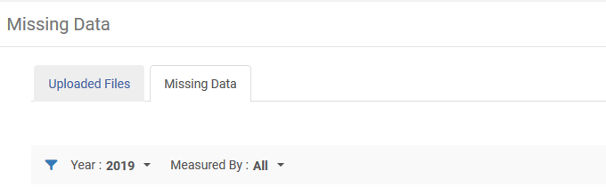
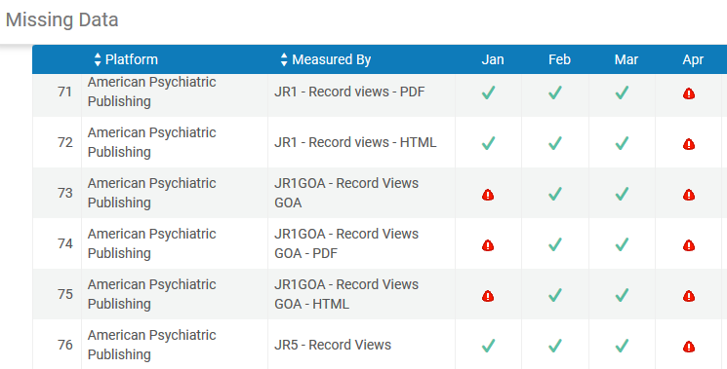
Introduction

Slide 7
Why might COUNTER data be missing

Slide 8
Why might COUNTER data be missing
If there is missing data this could be caused by one of the following two reasons:
The institution never loaded a report for the specific time period because
  It was not supplied by the vendor to the institution for manual upload
    In this case the vendor should be contacted by the institution to obtain the report
  It was supplied by the vendor to the institution for manual upload but the institution never uploaded it
    In this case the institution can still upload it
  It was not supplied by the vendor via SUSHI harvesting
    In this case the vendor should be contacted by the institution to have the report be made available for SUSHI harvesting

Slide 9
Why might COUNTER data be missing
The report was supplied by the vendor but was invalid
  In this case the institution should
    View the upload process of the file at "Acquisitions > Import > Load Usage Data" and filter by relevant report type and time period
    If the report appears and has status "Invalid" then from here it can be downloaded and be
      Compared to an existing valid report to see where and why it is invalid
      Sent back to the vendor as "invalid" with a request for a new report

Slide 10
Troubleshooting the missing COUNTER data

Slide 11
Troubleshooting the missing COUNTER data
Case one: File not received
On the next slide we can see from the “Uploaded Files” tab that the only files loaded for JR1GOA for 2019 were from Feb. and Mar.
This means that there was not an invalid file received
Rather … the file was never received from the vendor
The vendor should be contacted to obtain the file.

Slide 12
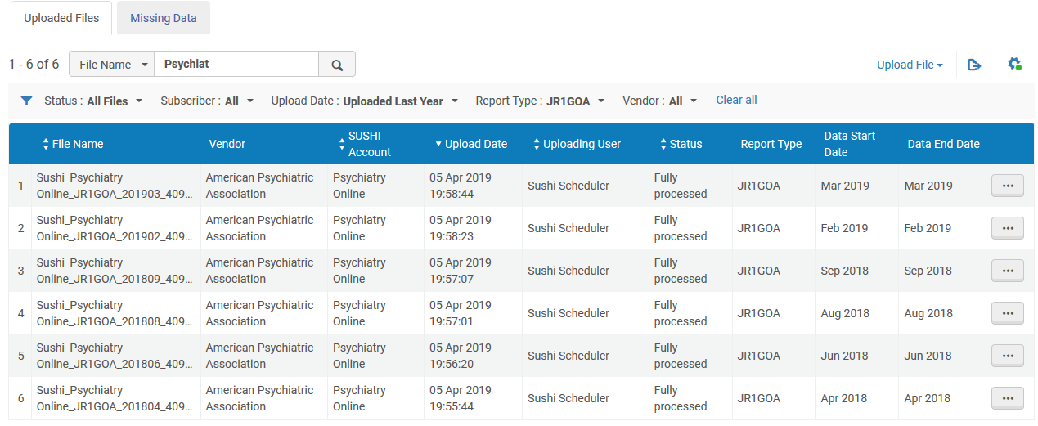
Troubleshooting the missing COUNTER data
Case one: File not received
No file for January was ever loaded

Slide 13
Troubleshooting the missing COUNTER data
Case two: File received and invalid
On the next slide we see that for ACM Digital Library JR1 the data for Jan. 2019 is missing but for Feb. And Mar. 2019 it is present.
This is suspicious because that means either it was
  not received
  received and has no usage
  received and was invalid

Slide 14
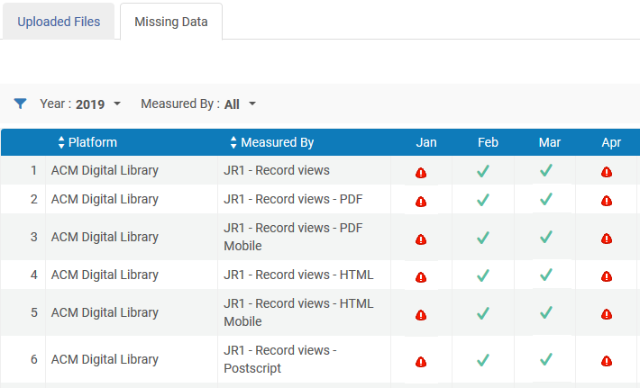
Troubleshooting the missing COUNTER data
Case two: File received and invalid

Slide 15
Troubleshooting the missing COUNTER data
Case two: File received and invalid
Looking at the “Uploaded Files” tab we see that it was loaded but was invalid.

Slide 16
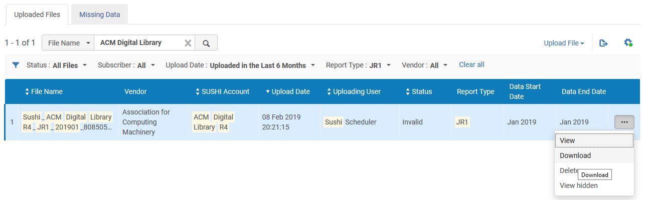
Troubleshooting the missing COUNTER data
Case two: File received and invalid
Download the file

Slide 17
Troubleshooting the missing COUNTER data
Viewing the xml COUNTER file we see that for the specified time period it has an invalid date format.
Instead of this (which we see if we compare to a valid file)
<s:UsageDateRange>
<s:Begin>2019-01-01</s:Begin>
<s:End>2019-01-31</s:End>
</s:UsageDateRange>
It has
<s:UsageDateRange>
<s:Begin>2019-1-01</s:Begin>
<s:End>2019-01-31</s:End>
</s:UsageDateRange>

Slide 18
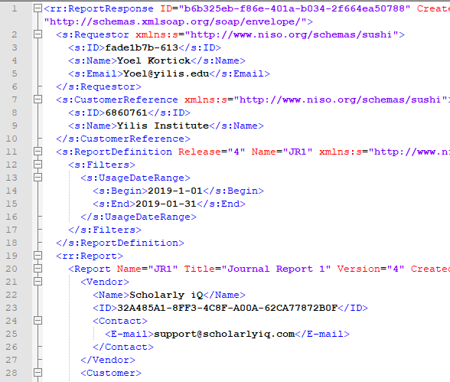
Troubleshooting the missing COUNTER data
Invalid file. Institution needs to tell vendor that an invalid file was received

Slide 19
xxx@exlibrisgroup.com

